Slide 1

Data Structures (15B11CI311) Odd Semester 2021
3rd Semester , Computer Science and Engineering
Jaypee Institute Of Information Technology (JIIT), Noida

Slide 2
Lecture: 26-27
Topics to be covered:
AVL Tree
Operations on AVL Tree

Slide 3
AVL Tree
Searching in a BST has O(n) worst-case runtime complexity, when n is the height of the tree
If we can maintain the height of a binary tree equals to O(log n), then search operation can be performed in O(log n)
The trees with a worst-case height of O(log n) are called balanced trees
An example of a balanced tree is AVL (Adelson-Velsky and Landis) tree

Slide 4
Definition of AVL Tree
It is a Binary Tree
If T_{L} and T_{R} are the left and right subtrees of a nonempty binary tree (T), then T will be an AVL tree if and only if
T_{L} and T_{R} are also AVL trees, and
|h_{L} – h_{R}| ≤ 1 where h_{L} and h_{R} are the heights of T_{L} and T_{R} respectively
An AVL search tree is a binary search tree that is also an AVL tree

Slide 5
Properties of AVL Tree
Height of an AVL tree with n nodes: O(log n)
Search time complexity in an n-node AVL tree = O(height) = O(log n)
Insertion into an AVL tree can be done in O(log n) time and resultant tree is also AVL tree
Deletion from an AVL tree can also be done in O(log n) time and resultant tree is also AVL tree

Slide 6
Representation Of AVL Tree
Generally represented using the linked representation
A balance factor (bf) is used with each node to perform the insertion and deletion
The balance factor bf(x) of a node x is defined as
bf(x) = height(x->lchild) – height(x->rchild)
Balance factor of each node in an AVL tree must be –1, 0, or 1
struct AVL { int data;
AVL *lchild, *rchild; int bf; };

Slide 7
AVL Tree with Balance Factor
-1
10
1
7
1
40
0
3
0
8
1
30
45
-1
0
0
0
-1
0
1
5
20
35
60
0
25

Slide 8
AVL Tree Operations
Searching
Similar to Binary Search Tree in O(log n)
Insertion
Deletion

Slide 9
Insertion/Deletion in an AVL Tree
Perform the Insertion or deletion in AVL tree like Binary Search Tree
After performing the operation, check the balance factor of each node
Case-01:
The balance factor of each node is either 0 or 1 or -1
The operation is concluded
Case-02:
The balance factor of at least one node is not 0 or 1 or -1
That is, the AVL tree is not balanced
Perform suitable Rotations to balance the tree

Slide 10
Insertion/Deletion in an AVL Tree (Case-01)
Insert(9)
-1
10
1
1
7
40
0
0
1
-1
3
8
30
45
0
0
0
-1
0
1
5
20
35
60
0
25

Slide 11
Insertion/Deletion in an AVL Tree Case-01
Insert(9)
-1
10
1
1
7
40
0
0
1
-1
3
8
30
45
0
0
0
0
-1
0
1
5
9
20
35
60
0
25

Slide 12
Insertion/Deletion in an AVL Tree Case-02
Insert(4)
-1
10
1
1
7
40
0
0
1
-1
3
8
30
45
0
0
0
-1
0
1
5
20
35
60
0
25

Slide 13
Insertion/Deletion in an AVL Tree Case-02
0
10
Insert(4)
Tree becomes unbalanced
Perform Rotation
2
1
7
40
-1
0
1
-1
3
8
30
45
0
0
1
-1
0
1
5
20
35
60
0
0
4
25

Slide 14
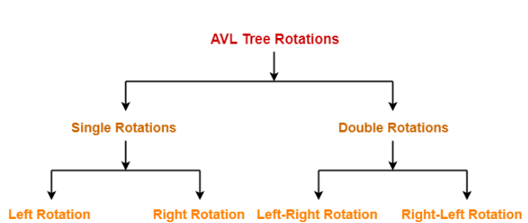
AVL Tree Rotations

Slide 15
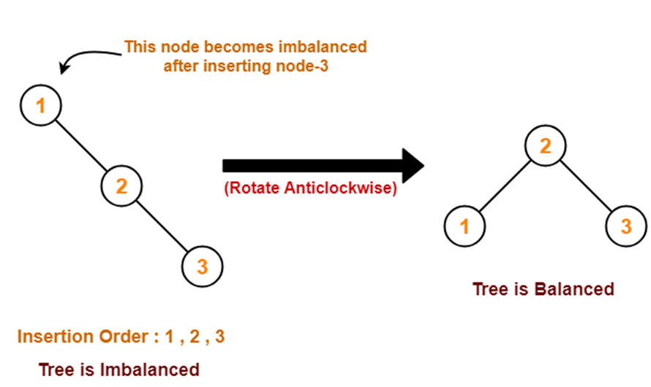
Case-01: Left Rotation

Slide 16
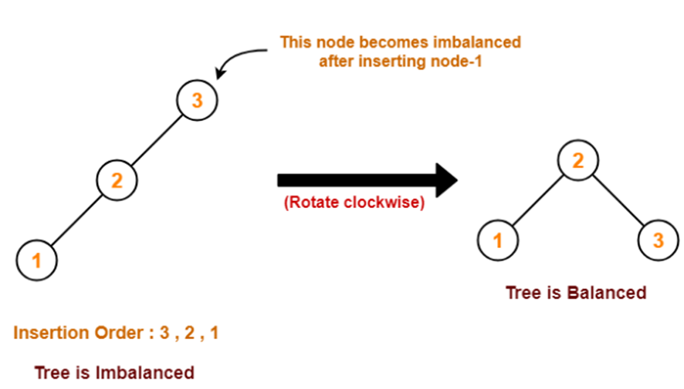
Case-02: Right Rotation

Slide 17
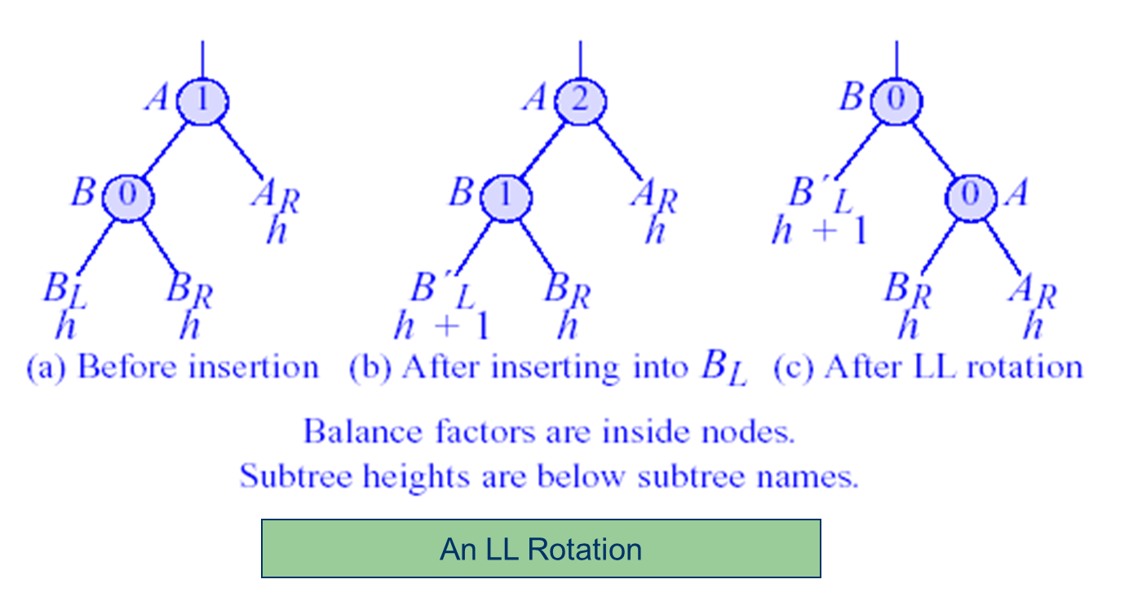
Case-01: Right Rotation
Similarly, we can do the rotation for Left rotation

Slide 18
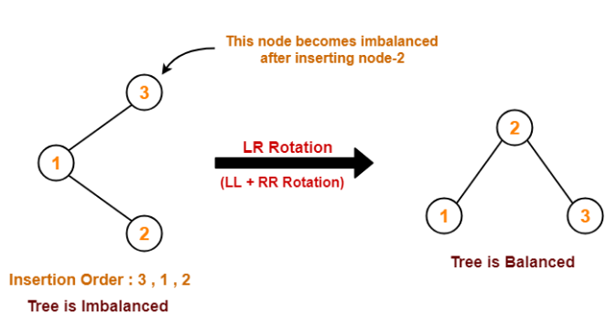
Case-03: LR Rotation

Slide 19
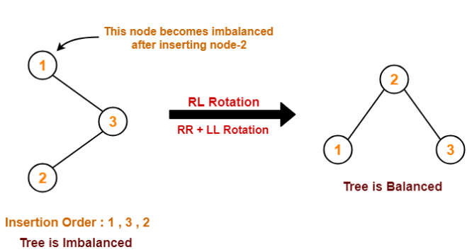
Case-04: RL Rotation

Slide 20
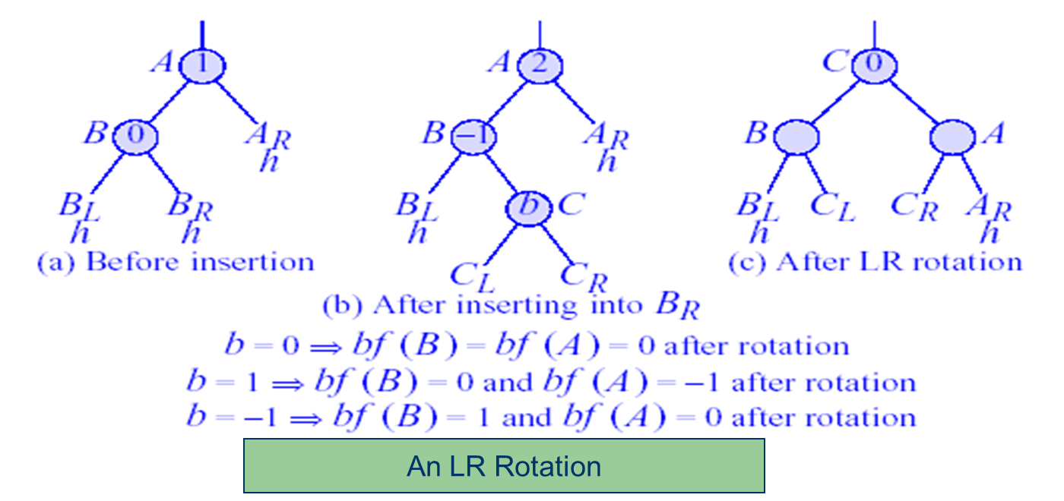
Case-01: LR Rotation
Similarly, we can do the rotation for RL rotation

Slide 21
Insertion in an AVL Tree: Example
Insert the following elements in an AVL tree and do the required rotations to balance it.
10, 7, 27, 9, 40, 3, 8, 30, 45, 1, 5, 20, 35, 60, 25, 4, 29,

Slide 22
Deletion in an AVL Tree
Perform the deletion in AVL tree like Binary Search Tree
After performing the operation, check the balance factor of each node
Case-01:
The balance factor of each node is either 0 or 1 or -1
The operation is concluded
Case-02:
The balance factor of at least one node is not 0 or 1 or -1
That is, the AVL tree is not balanced
Perform suitable Rotations, as described previously, to balance the tree

Slide 23
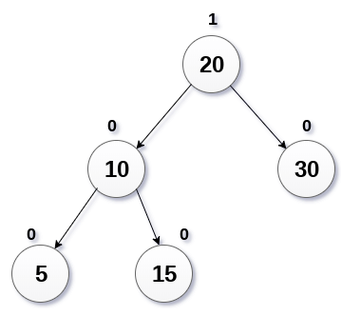
Deletion in an AVL Tree
Delete 30 from the below AVL tree

Slide 24
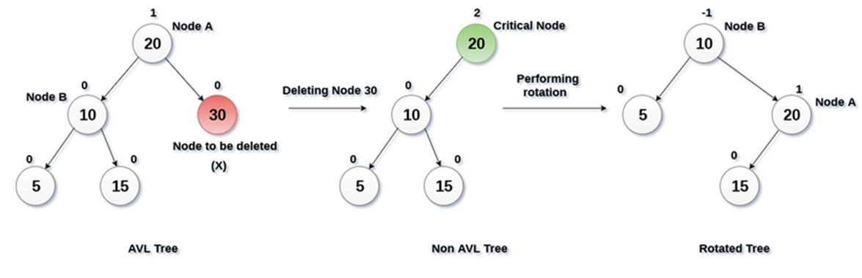
Deletion in an AVL Tree
Delete 30 from the below AVL tree

Slide 25
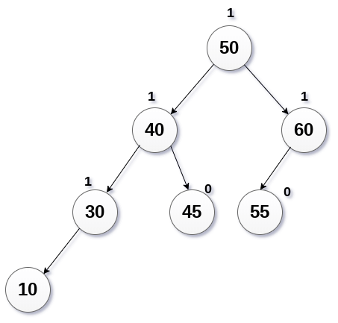
Deletion in an AVL Tree
Delete 55 from the below AVL tree

Slide 26
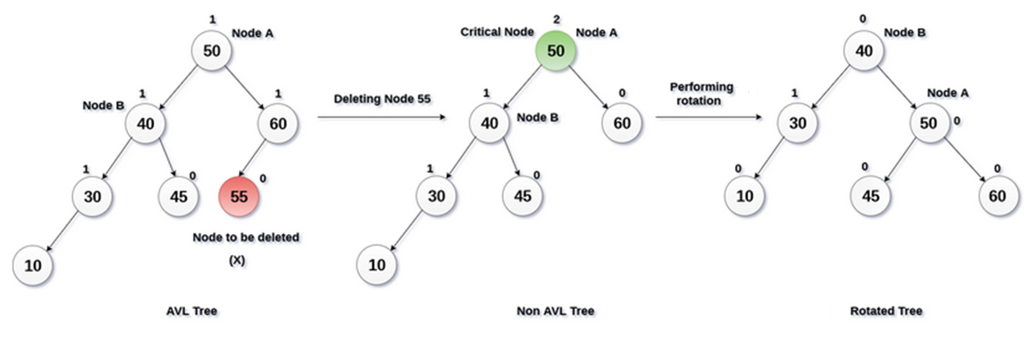
Deletion in an AVL Tree
Delete 55 from the below AVL tree

Slide 27
Reference
https://nptel.ac.in/courses/106/103/106103069/
https://www.cs.cmu.edu/~wlovas/15122-r11/lectures/18-avl.pdf
https://www.gatevidyalay.com/avl-tree-avl-tree-example-avl-tree-rotation/
https://www.javatpoint.com/deletion-in-avl-tree
https://www.javatpoint.com/avl-tree
http://dpnm.postech.ac.kr/cs233/

